Slide 1
Deep Learning
Name- Pooja Sharma
Roll No- L00171181
Atlantic Technological University

Slide 2
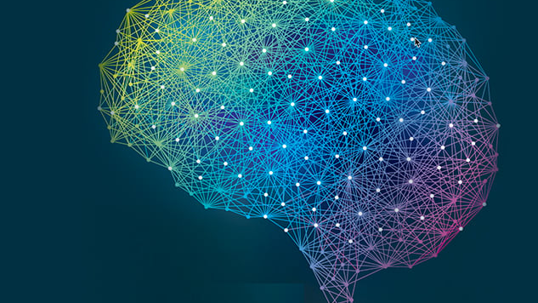
Deep Learning Approach for Handwritten Digit Classification using Convolutional Neural Networks
Digits MNIST Classification using CNN

Slide 3
CNN Layers
Input Layer: The input layer receives the raw input data, which could be images, text, or numerical values. It acts as the entry point of the neural network and does not involve any computations.
Convolutional Layer: In Convolutional Neural Networks (CNNs), convolutional layers apply a set of filters to the input data. Each filter performs a convolution operation by sliding over the input and calculating dot products between the filter weights and local patches of the input. These layers are particularly useful for capturing spatial patterns in images.
Pooling Layer: Pooling layers are typically inserted after convolutional layers. They reduce the spatial dimensions of the feature maps generated by the convolutional layers by downsampling. Popular pooling techniques include max pooling, which selects the maximum value in each patch, and average pooling, which takes the average value.
Fully Connected Layer: Also known as the dense layer, the fully connected layer connects each neuron to every neuron in the previous and next layers. This layer is responsible for learning high-level representations and making predictions. Each neuron in the layer applies a linear transformation followed by an activation function to produce its output.
Output Layer: The output layer provides the final predictions or outputs of the neural network. The number of neurons in this layer depends on the specific task. For classification tasks, the output layer often uses the softmax activation function to produce a probability distribution over the classes.

Slide 4


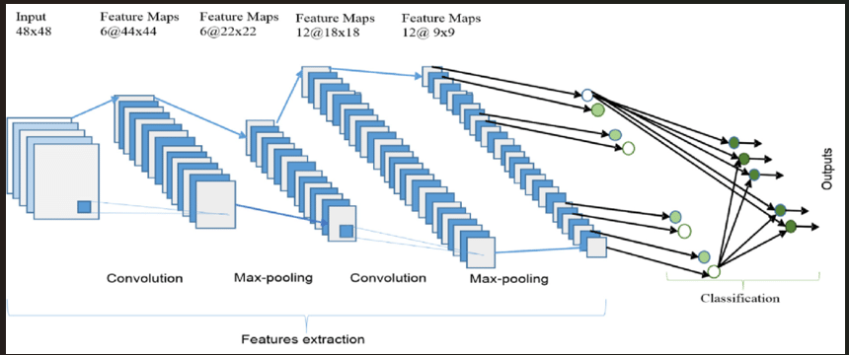



CNN Architecture

Slide 5





MNIST DataSet along with code

Slide 6
About DataSet Website: https://www.kaggle.com/c/digit-recognizer
The dataset is made up of a sizable number of photos in grayscale, each of which shows a handwritten numeral from 0 to 9.
The dataset is split into two sets: a training set and a test set, the former of which contains labeled images for model training and the latter of which contains unlabeled images for evaluation. Due to the differences in writing styles and digit quality in this dataset, the assignment is difficult. It gives academics and data scientists a fantastic opportunity to create and improve machine learning models, especially Convolutional Neural Networks (CNN) for precise digit recognition.
Task: To correctly identify digits from a dataset of tens of thousands of handwritten images in the test dataset

Slide 7

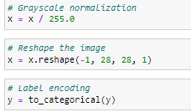
Data Preprocessing
The dataset is loaded from the "digit.csv" file, which includes both training and testing data. The features and labels are separated, and the images are normalized by dividing pixel values by 255.0. The images are then reshaped into a suitable format for CNN input. The labels are one-hot encoded to prepare them for multi-class classification.

Slide 8

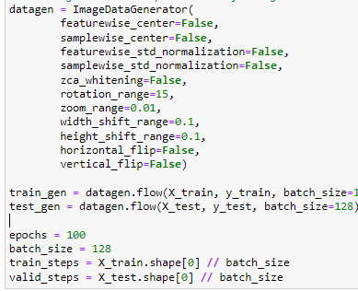



Data Argumentation to prevent overfitting

Slide 9
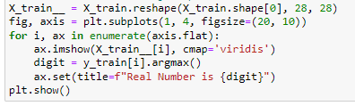
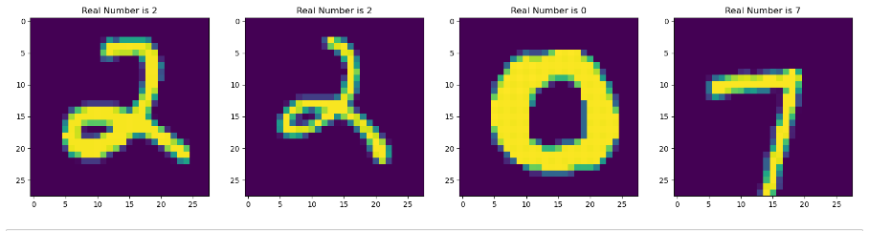
Visualize some Training Samples

Slide 10
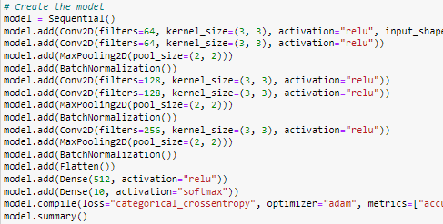
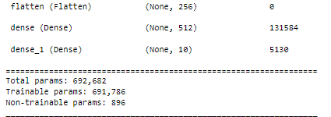
Model Architecture:
Multiple convolutional layers with ReLU activation, followed by max pooling and batch normalization layers, make up the CNN model architecture. The final output layer in the model has softmax activation for digit classification and is made up of completely connected layers with ReLU activation. Categorical cross-entropy loss is used to build the model, and the Adam optimizer is used to train it.

Slide 11
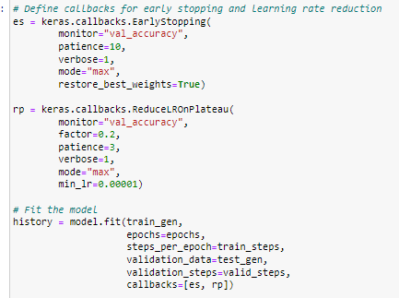
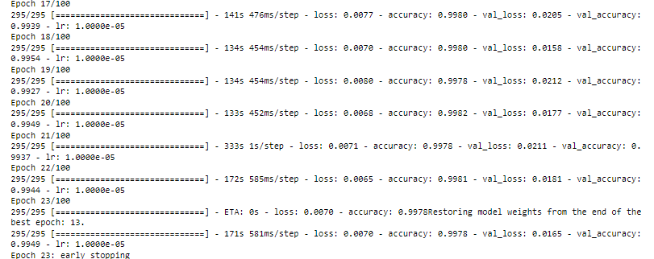
Model Training and Evaluation:
Using the ImageDataGenerator class from Keras, data augmentation techniques are used to avoid overfitting. The model is trained using a 128-batch size across 100 epochs. To provide the best model performance, early halting and learning rate decrease callbacks are put into place. Plots are used to track and display the accuracies and losses during training and validation.
The fit function is employed in the model's training. To create enhanced samples, the data generator is fed the training data. To enhance model performance and avoid overfitting, callbacks with early stopping and learning rate decrease are utilized. The history object contains the training history.

Slide 12
Epoch-Training Loss and Accuracy
Epoch: In the context of machine learning and neural networks, an epoch refers to a complete pass through the entire training dataset during the training phase.
In other words, one epoch means that the model has seen and processed every training example once.
Epoch 1/100: The model starts training. The training loss is 0.1585, and the training accuracy is 0.9495. The validation loss is 1.6386, and the validation accuracy is 0.3567.
Epoch 2/100: The model continues training. The training loss decreases to 0.0658, and the training accuracy improves to 0.9801. The validation loss decreases to 0.2091, and the validation accuracy improves to 0.9302.
Epoch 3/100: The model further improves as the training loss decreases to 0.0492, and the training accuracy increases to 0.9848. The validation loss decreases to 0.0767, and the validation accuracy increases to 0.9766.
The training eventually stops at Epoch 23 due to early stopping, which means that the model did not improve significantly after a certain number of epochs, and the weights of the model are restored to the point where it achieved the best validation performance (Epoch 13).. loss:
Loss: The value of the loss function during training. In this case, it starts at 0.1585 in epoch 1 and decreases over subsequent epochs.
Accuracy: The training accuracy of the model. It starts at 0.9495 in epoch 1 and increases over subsequent epochs. val_loss: The value of the loss function on the validation set. It indicates how well the model is generalizing to unseen data. val_accuracy: The accuracy of the model on the validation set.
The learning rate used during training. It starts at 0.0010 and decreases over time due to a learning rate schedule.

Slide 13

Model Evaluation and Analysis:
On the test set, the trained model is assessed, and predictions are made for performance analysis. The classification performance of the model is displayed using a confusion matrix. In order to evaluate the model's accuracy visually, sample test images with their real and anticipated labels are provided.

Slide 14
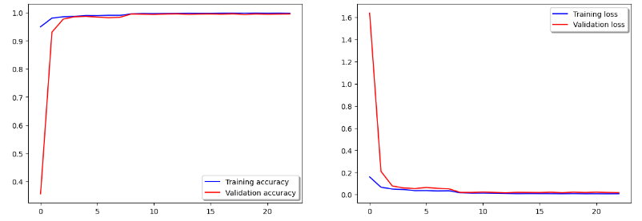
Training Accuracy and Validation Loss

Slide 15
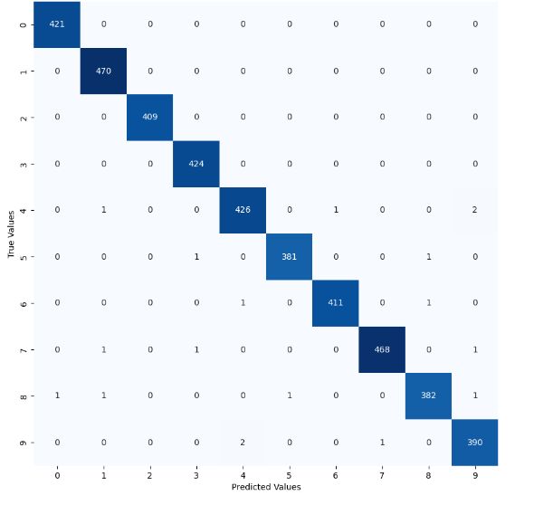
Confusion Matrix (HeatMap)

Slide 16
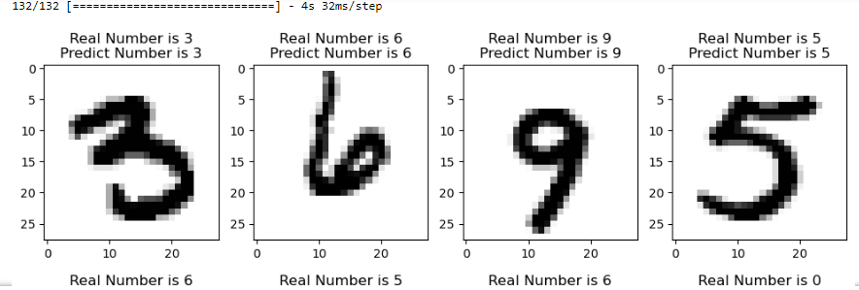
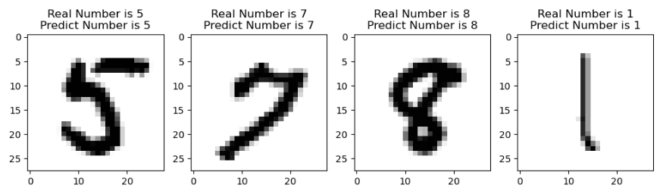
Model Predictions

Slide 17
Conclusion/Future Work
In order to categorize handwritten digits, we created a convolutional neural network (CNN) model in this project using Keras and TensorFlow. The MNIST dataset, which includes 10,000 test samples and 60,000 training samples, was used to train the model. We started by preprocessing the dataset, reshaping the photos to the necessary format, and normalizing the pixel values. Then, we divided the data into training and test sets, using 90% of the training data and 10% of the test data for evaluation. To extract pertinent characteristics from the images, the CNN architecture included a number of convolutional layers, followed by layers for batch normalization and max pooling. Convolutional layer output was flattened and then passed through fully linked layers to create the final output layer, which had 10 units to represent the digits 0 to 9. Categorical cross-entropy loss and the Adam optimizer were used to train the model.Using the Keras ImageDataGenerator, data augmentation methods including rotation, zooming, and shifting were used to the training data to avoid overfitting. To enhance generalization and convergence, early halting and learning rate reduction callbacks were also used during training.6The model was trained using a 128-batch size across 100 epochs. After 10 epochs, the training procedure produced promising results, with a peak validation accuracy of roughly 99.49%. The accuracy and loss graphs showed that the model performed well in both the training and validation datasets.A confusion matrix was used to assess the model's performance, and the results showed high accuracy and accurate predictions for the majority of digits.

Slide 18
Conclusion/Future Work
For a selection of test photos, the model's predictions were displayed alongside the appropriate true labels.In conclusion, this CNN model performed exceptionally well at correctly classifying handwritten digits. It demonstrated the effectiveness of convolutional neural networks and deep learning for image categorization tasks. The trained model can be used in additional applications to recognize numbers.The digit classification model will be improved in the future by investigating other CNN architectures, enhancing hyperparameters, putting more data augmentation approaches into practice, utilizing transfer learning, and experimenting with ensemble learning. Other potential areas of emphasis include conducting error analysis, creating real-time digit recognition systems, and enhancing the model for use on devices with limited resources. Last but not least, expanding the model to include multi-digit recognition tasks and using it with more datasets will help.

Slide 19
THANK YOU

